Slide 1
Lab - Secure your API

Slide 2
Wherein ...
We secure our Retail Proxy using our new Retail API Product
By adding verification of our API (Consumer) Key

Slide 3
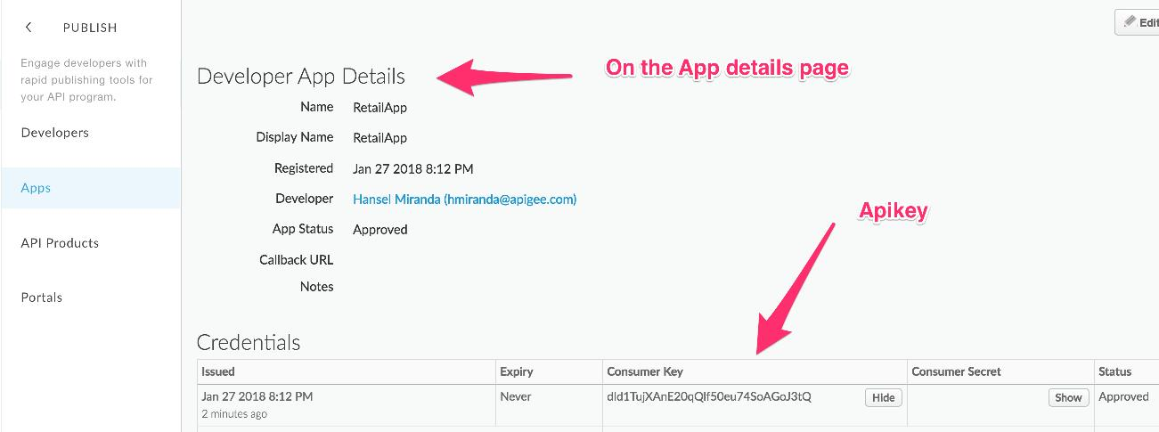
Verify API Key
On the Developer Apps Details Page, find your APIKEY:

Slide 4
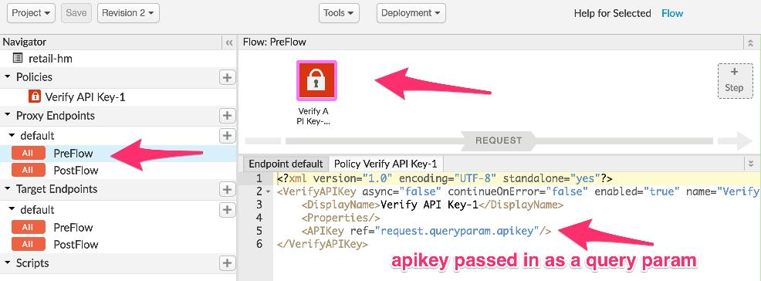
Verify API Key
Add the VerifyAPIKey policy to your proxy

Slide 5
Test
Add to your test URL:
"?apikey=<yourapikeyfromyourdeveloperappgoeshere>"
== "Consumer Key" == "Client ID" == "Application Key" == …

Slide 6
THANK YOU

